Slide 1

Iowa Liquor Sales
Pratinav Jinwal
0828975

Slide 2

AGENDA
* Introduction
* Observation & Recommendation
* Conclusion

Slide 3
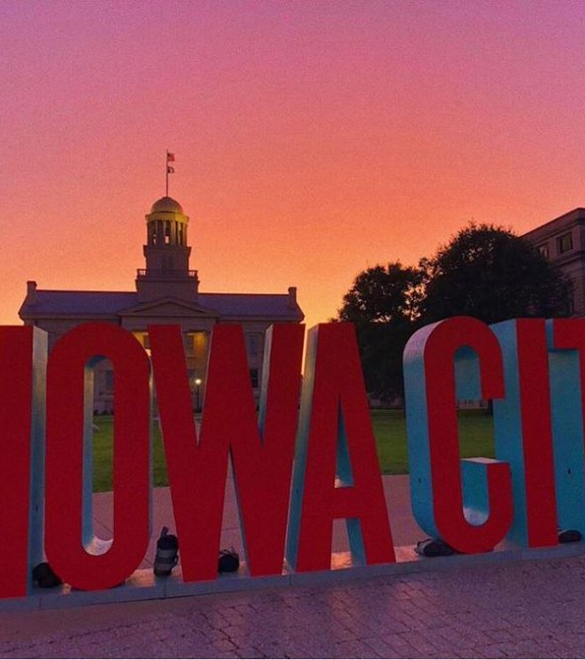
Introduction
Iowa, with its diverse counties and communities, has a rich tapestry of liquor retail establishments, each contributing to the complex web of consumer preferences, economic factors, and regulatory influences. In this presentation, we will explore key aspects of liquor sales, from the distribution of sales across various stores to the impact of bottle volume and pricing strategies.

Slide 4

OBSERVATIONS and Recommendations

Slide 5
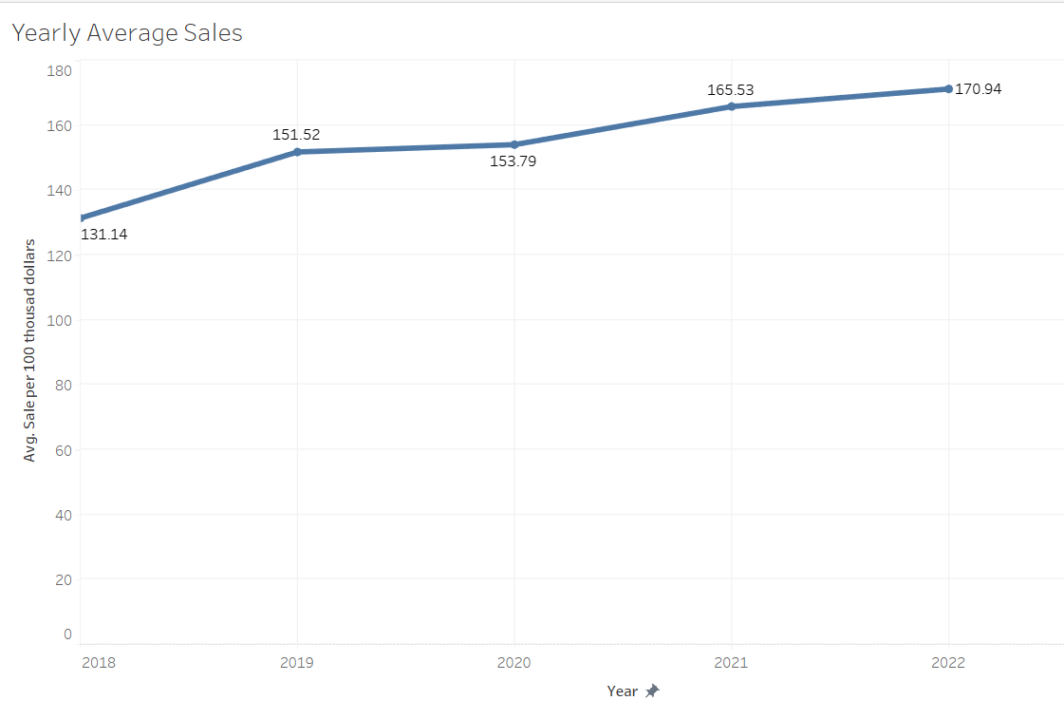
Observation
Steady Growth: The line chart illustrates a generally upward trajectory in average yearly sales, suggesting increase in growth trend in Iowa's liquor industry. This growth could be attributed to various factors, such as population changes, economic conditions, or shifts in consumer preferences.
Recommendations
Stay Informed on Market Dynamics- Stay tuned with the market trends and keep an eye on factors which might impact sales such as economic conditions ,regulations

Slide 6
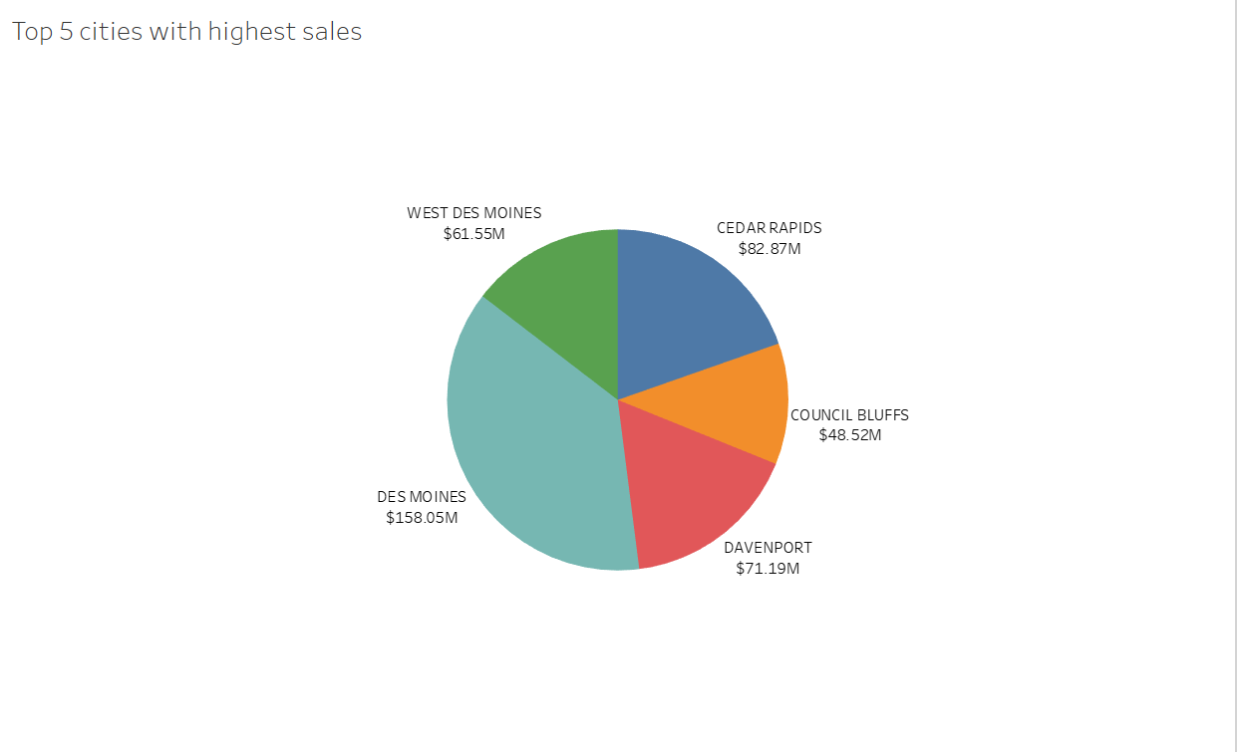
Observation
Identifying Dominant Players: A quick glance at the pie chart allows us to identify which cities are the dominant players in the Iowa liquor market.
Recommendations
Customer Engagement Strategies: Implement customer engagement strategies that resonate with the demographics and preferences of residents in each city. Understanding local consumer behaviors is essential for building lasting connections and driving sustained sales growth.

Slide 7
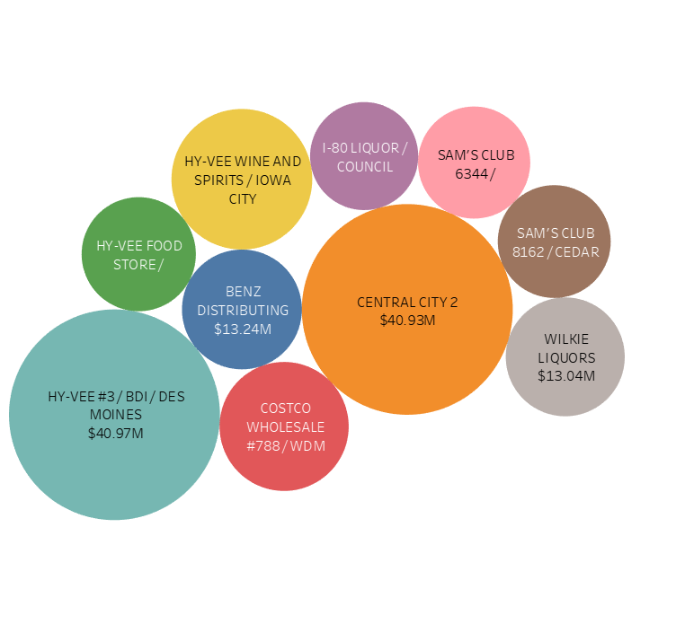
Top 10 Stores with highest Sales
Observation
Concentration of Sales: The pie chart vividly showcases the concentration of sales within the top 10 stores, revealing the proportional contribution of each store to the overall liquor sales landscape in Iowa.
Recommendations
Data-Driven Decision-Making: Utilize sales data from top-performing stores to inform strategic decision-making. Analyze purchasing patterns, consumer behaviors, and market trends specific to each store to optimize product offerings and promotional activities.

Slide 8
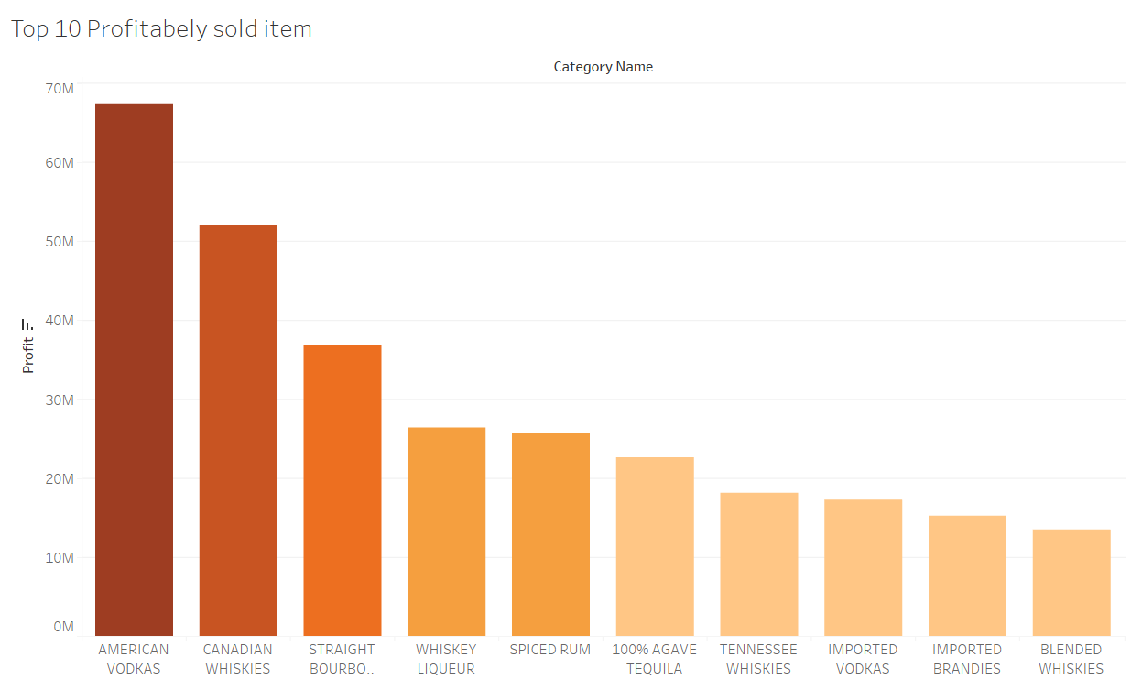
Observation
Diversity of Products: The top 10 list may showcase a diverse range of liquor products, representing various categories, brands, or sizes. Understanding the diversity within the most profitable items allows for a nuanced appreciation of consumer preferences and market trends
Recommendations
Promotional Campaigns: Leverage the popularity of the most profitable items in marketing campaigns. Highlighting these items in promotions, advertisements, or special events can create buzz and drive additional sales

Slide 9
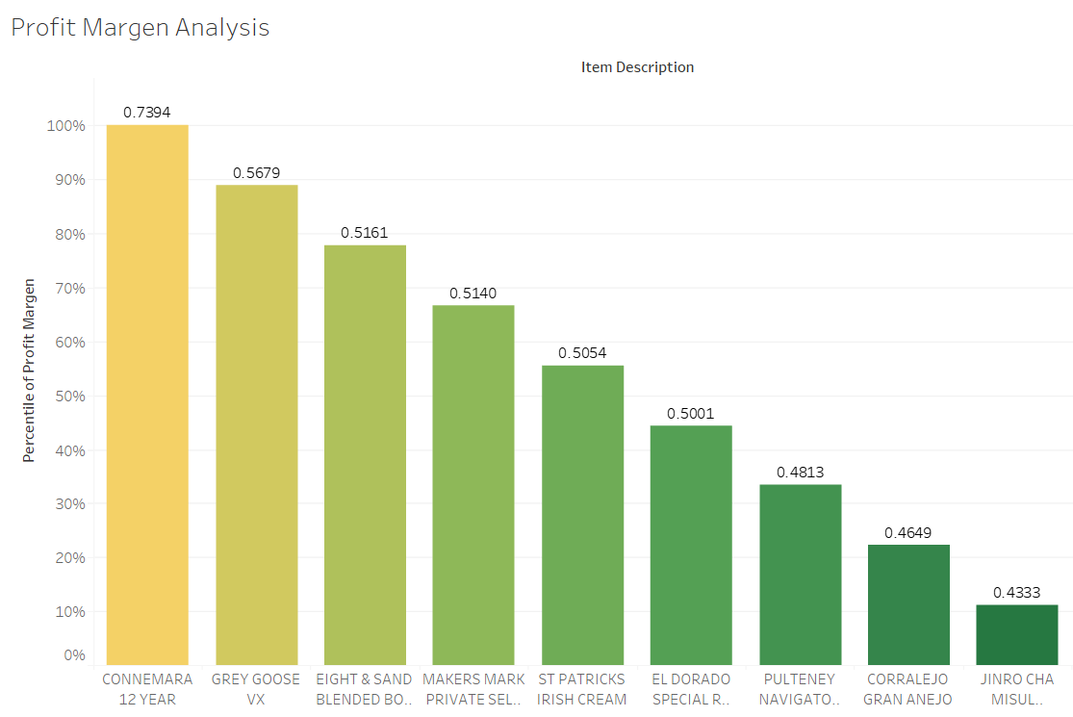
Observation
Varying Profit Margins: The bar graph visually presents the profit margins of the top 10 items, showcasing the range and variability in the profitability of each product.
Recommendations
Cost Analysis and Reduction: Conduct a thorough cost analysis of items with lower profit margins.

Slide 10

CONCLUSION
In this comprehensive exploration of Iowa's liquor sales dataset, we've traversed the intricate landscape of the state's alcohol market, uncovering valuable insights and trends. From analyzing average yearly sales in top cities to identifying the top-performing stores and most profitable items, our journey has provided a nuanced understanding of the factors shaping the industry.

Slide 11

THANKS

